Slide 1

“janitor” Package in R
This is the full version of our slides. We cut some slides off (for time-sake) when we turned it into the pdf that we presented. We needed it to be a pdf to effectively do a split-screen presentation! Please refer to the pdf file to see what we ended up presenting.
Meadow Monticello
Nick Zywalewski
Notes:
meadow

Slide 2

Presentation Outline
Package overview
Our data set
Implementation in R
Takeaways and our experience with data cleaning
OoOOoOo! What’s that?
Notes:
n

Slide 3

What is the “janitor” package?
clean_names()
tabyl()
get_dupes()
get_one_to_one()
Published on 12-22 (Meadow’s birthday) -2024 and created by Sam Firke
Cleaning
  Parses, appends, converts symbols, and (adds/removes) spaces
  Removing of empty rows/columns and columns with constant values
  Converting date formats
Exploring
  Search records for duplicates and specific value combinations
  Inspect one-to-one relationships
  Building tables
  Count factor levels
Notes:
m

Slide 4
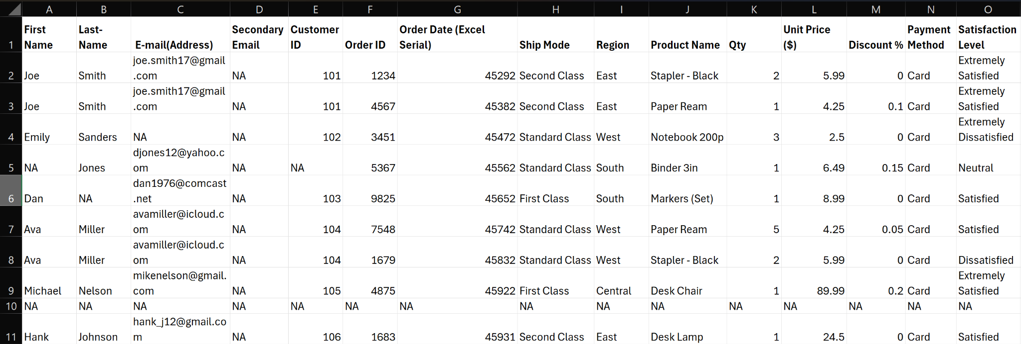
The Data Set
Notes:
n
Here we can see that the data set can/should be cleaned. We want to remove the secondary email column, the blank row (10), alter other formatting, and explore the data in various ways

Slide 5

Implementation of Package with Data Set
janitor package be like…
Notes:
m

Slide 6
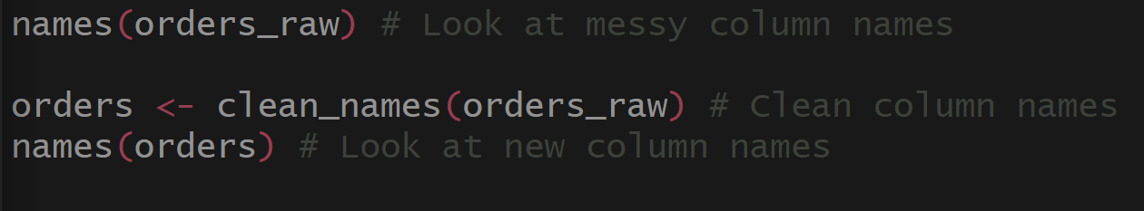
Cleaning: Column Names
This cleans the column names of our dataset, ensuring that there are no funky symbols or spaces in them.
Notice how the output will utilize underscores to fix this.
Notes:
n

Slide 7
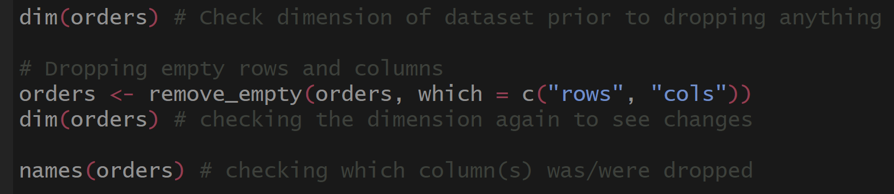
Cleaning: Dropping Empty Rows and Columns
Here, we remove empty rows and columns.
Notice how there is one row and one column that get dropped after this cleaning step.
10X15 → 9X14
Notes:
M
We can tell it worked because our dimensions decreased. We checked before and after. 10,15 to 9,14. Consistent with visual inspection of data. After check column names and see that secondary email name field is no longer in our list of column names.

Slide 8
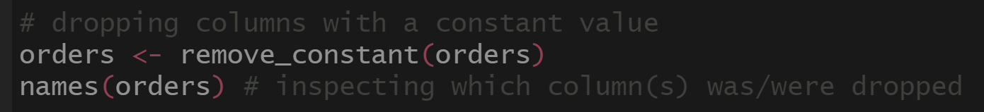
Cleaning: Removing Columns with Constant Values
Since everyone paid with a credit card, notice how “Payment Method” is no longer in our list of column names.
Notes:
M
We can tell it worked because our dimensions decreased. We checked before and after. 10,15 to 9,14. Consistent with visual inspection of data. After check column names and see that secondary email name was dropped

Slide 9
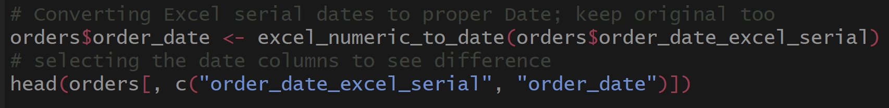
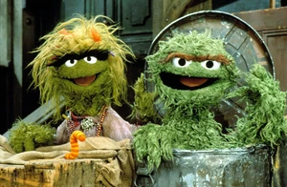
Cleaning: Date Conversion, Altering Cells
In some settings, Excel serial dates are used instead of a more user-friendly date description.
This function allows us to convert this Excel serial date
into a more traditional way of expressing a
date: yyyy-mm-dd.
Oscar on a date… different kind of date.
Notes:
n

Slide 10
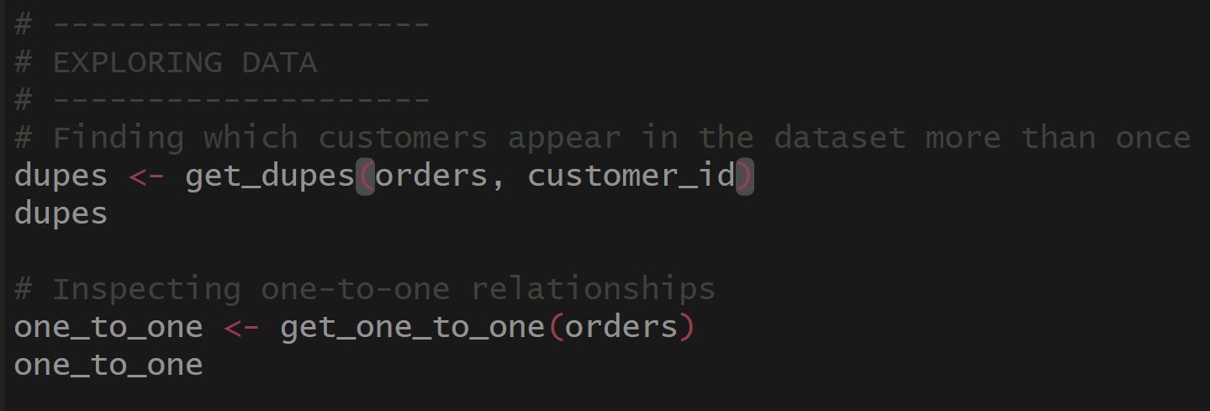
Exploring: Duplicates
Here, we are taking a look at rows that have similar data in them. In this particular example. We are examining which customers placed multiple orders.
Notice how the output allows us to see all of the details in these cases.
Notes:
N

Slide 11
Exploring: One-to-One Relationships
Here, we are taking a look at rows that have similar data in them.
Here, we are taking a look at one-to-one relationships, meaning which fields of data correspond directly with other fields.
This could be helpful, especially if there were many more rows of data. This information could help someone determine how to design a database system to store the data and identify cardinalities among tables.

Slide 12
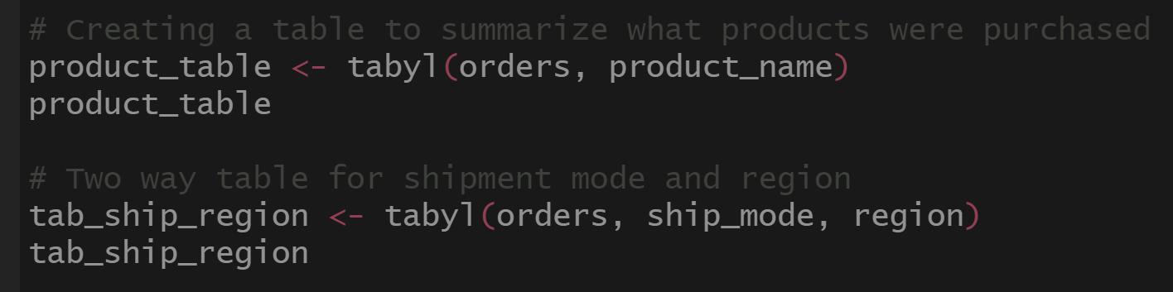
Exploring: Table Creation
Here, we are building tables consistent with what variable(s) we are interested in. One-way and two-way tables help us see relationships between variables and to quickly count frequencies, compare groups, and identify patterns in the data.
Notes:
N

Slide 13
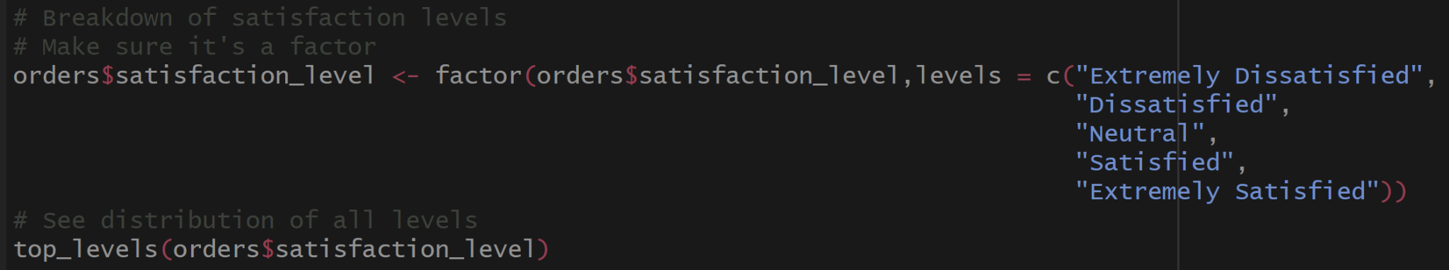
Exploring: Viewing of Levels
Here we recoded the satisfaction variable as a factor and used the top_levels function to quickly view the ordered categories.
Notice how the output clearly displays the distribution of responses across all satisfaction levels, making it easy to compare them.

Slide 14
Our Experience and Takeaways
DSS 416, Data Wrangling and Visualization
  Fe Y Alegría
DSS 420, Data Mining
DSC 225, Data Science of Sports
MAT 470, Statistics in Research
These classes all dealt with filthy data. Utilizing “janitor” would have helped tremendously. I am curious if there exists similar packages in Python and if so how they might differ.

Slide 15
References
https://cran.r-project.org/web/packages/janitor/index.html
https://cran.r-project.org/web/packages/janitor/vignettes/janitor.html#clean-dataframe-names-with-clean_names
https://www.rdocumentation.org/packages/janitor/versions/2.2.1
https://www.r-bloggers.com/2024/08/top-25-r-packages-you-need-to-learn-in-2024/
Also the “help” function came in handy!

Slide 16

Any questions? Thank you!
Now scram!!!
Oscar the Grouch when the data isn’t clean. JK he loves the grime.

